Slide 1


One Day Reps Training Course
*LA Name here*
xxxx (Organiser)
xxxx (LA Secretary)

Slide 2
Course Aims
Understand your role and rights as union rep in the workplace
Understand our EIS structures and points of contact for support
Understand how to build your branch, including how to recruit and retain members
Be able to identify different types of casework and the most appropriate support
Understand collective bargaining and negotiating structures at school and Local Association level

Slide 3
Ice-breaker activity
Why did you decide to become a rep?
What do you think is the role of a union rep?

Slide 4
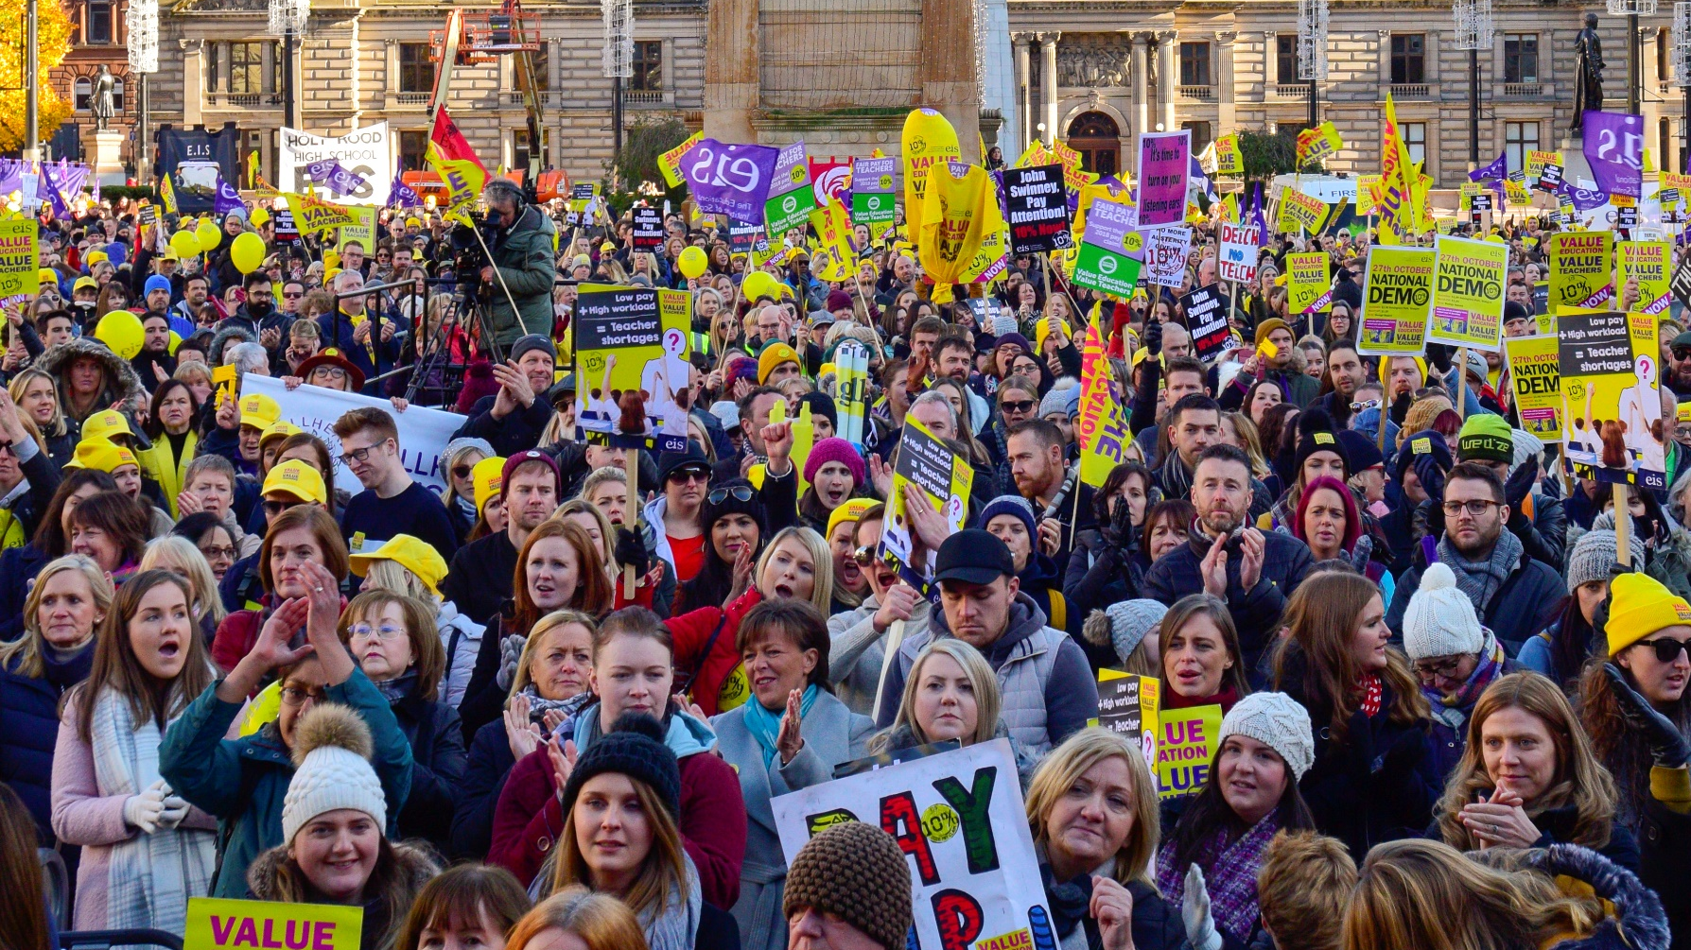
What is a trade union?
Group of workers who join together to improve their conditions at work
Represents members’ interests and provides the knowledge, support and confidence needed to raise and address workplace issues
Building member participation in their union through organising in the workplace.

Slide 5
Trade Union representatives’ duties and responsibilities
Your Rights as a Union Rep
Trade Union Reps have rights as per the Trade Union and Labour Relations (Consolidation) Act 1992 aka TULRCA
Reps undertake a variety of roles in collective bargaining, working with management, communicating with members, liaising with their TU and handling individual disciplinary and grievance matters on behalf of members.
Reps are entitled to “reasonable” time off. This is typically related to the size of branch you represent.
There will be a local (LNCT) agreement negotiated between the TU
and Local Authority stating what ‘time off’ for union duties reps have.
The employer has responsibilities with trade unions such as to consult the
TU and to provide certain facilities so reps can carry out their duties.
Notes:
There is a difference between TU duties and TU activities in ACAS.

Slide 6
Our local and national structures
School Branches- electing reps, highlighting issues and raising motions
Local Associations- providing local representation and leadership
National Committees- elected positions and action decisions made by main representative bodies
National Council- 139 elected member representatives
Annual General Meeting - main decision-making body
EIS members directly influence and shape union campaigns, policy and priorities at every level of the union.
Notes:
Motions can be debated at branch or local level. Motions for AGM can be proposed from branches and Local Associations.

Slide 7
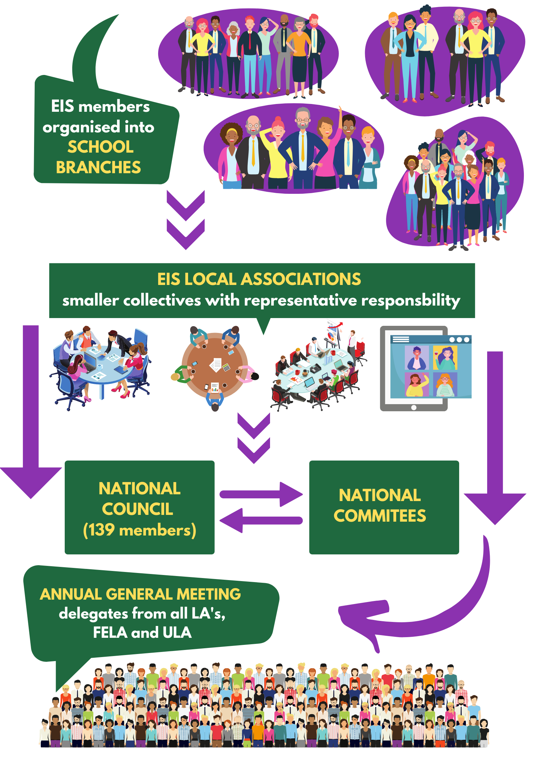

Slide 8

Trade Union representatives’ duties and responsibilities
Why is it important to build a strong branch?
To build collective strength
To give members confidence
To gain greater control over our working lives
To assert all our workplace rights

Slide 9

Value Education
Value Teachers
In 2018, we successfully campaigned for and won a historic 13% pay rise for teachers.
This began as a motion from branches that was passed at the 2017 EIS AGM
Campaigning activities were carried out by members and EIS staff throughout 2017. This included: lobbying councillors and elected members, sending 25k postcards to the DFM, petitions, street stalls, flyering, local static demos, union meetings, training, stickering, wearing pay campaign t-shirts and hats.
This culminated in the largest Trade Union demonstration in post-war Scotland where thirty thousand teachers and supporters took to the streets of Glasgow in October 2018
How did your branch support the campaign?

Slide 10
Handling Members’ Problems
You are the first point of contact for members in your school
As a fully trained rep, you may need to:
Give general employment advice
Deal with potential grievance and disciplinary matters
Negotiate with the headteacher on a member’s behalf
Refer serious cases to your LA Secretary or Area Officer
As a new rep, you aren’t expected to take on cases immediately
You will act as a point of contact and refer cases to your Local Association Secretary

Slide 11
Grievance and disciplinary procedures
A disciplinary procedure is used by an employer to address an employee’s conduct or performance.
A grievance procedure is used to deal with an employee’s problem or complaint.
Collective v. individual grievances
Grievances are a key tactic that we use to win the changes we want to see.

Slide 12
Identifying the Problem
Find a quiet place to chat and be sympathetic, especially if your member is upset or angry.
Remember: who, what, where, when, why.
Get all the facts. Record a note of the conversation’s key points.
In the case of potential disciplinary cases, if the member has not been made aware of the exact detail of any allegation you should ask for this to be provided by the Headteacher.
Collect further information, then either develop a plan using the information that you have collected or seek advice if the case is serious.
Share next steps with your member.

Slide 13
Activity: Handling Members’ Problems
Discuss the scenarios in your Participants’ Guide.
How would you deal with each scenario? What facts would you try to get? What do you think the nature of the problem is? What skills would you use as a rep?

Slide 14
Case Handling
  Case Handling Protocol:
Provisos about:
retired/former teachers
incidents pre-dating membership
alternative representation
support to management
re-registration and registration conditions
Criminal matters:
Escalate to EIS HQ IMMEDIATELY if:
the issue is particularly serious and/or sensitive such as allegations of a criminal nature or sexual misconduct; or
a member is contacted by the police for interview or is arrested and requires legal advice/representation.

Slide 15
9 Issues for School Reps/ Branch Reps
1 Use of Employer IT systems
Hot topic in the College Sector - mainly concerns School/ Branch Reps.
Recognition agreements generally cover the use of employer’s telephone and internet facilities.
EIS Data on an employer’s server remains EIS Data and the Institute is the data controller.
However, remember ‘sent email’ from an employer’s account will be accessible by them.
  2 Use of Own Devices
Meeting notes and supporting documents
Use of EIS Database to send bulk emails to members rather than a personal email account.

Slide 16
Collective Bargaining
Collective bargaining is the process of negotiation that trade unions and employers carry out in order to come to an agreement that applies to a group of workers
As an EIS member, your terms and conditions are negotiated at the Scottish Negotiating Committee for Teachers (SNCT) and your Local Negotiating Committee for Teachers (LNCT)
Every council has an LNCT and each union has representatives at the LNCT, including your LA Secretary
The LNCT has the power to vary certain devolved matters locally
We can all achieve more together than we can alone.
When we stick together we’re much more likely to win the changes we want to see.

Slide 17
Negotiation
The process by which the employer and TU establish an agreed output, e.g. agreement or decision. In negotiations the parties are equal and the responsibility for an output is jointly held between the two parties. [It is distinct from consultation where the responsibility for decision making lies with the employer.
Negotiation is a method of resolving conflicting aims. Whilst it can be a formal set piece process, it is an everyday activity.
Negotiation can be a long or short process and may involve leveraging the TUs position by campaigning in order to move the employer to an agreement point.

Slide 18
Activity: Negotiating the best outcomes
Read the statements in your Participant’s Guide
How far do you agree or disagree with them?

Slide 19
Working Time Agreement
A collective agreement reached at school level between the trade union(s) and the Headteacher
Reviewed annually
Governs the allocation of time for defined activities beyond class contact and teachers’ preparation and correction time
There should be an LNCT agreement-check SNCT website or LA website
The most important aspect of the process is that it must have been negotiated and finally agreed between staff and school management
Once negotiations are completed, it is signed off as agreed by the Rep and Headteacher
The agreement is binding on all staff.

Slide 20
WTA Process
Revise/amend the WTA as per branch decision
Advise other TUs in the school of the EIS position
Present proposals to management for negotiations
Take outcome of negotiations back to branch for decision
EIS Rep signs off agreement
If no agreement, escalates to LNCT then SNCT
Have a branch meeting once a term and build in time to review the WTA

Slide 21


Slide 22
Class contact time 22.5h a week | Personal allowance 7.5 h a week | Remaining time 5h x 39= 195 WTA
Class Contact Time – maximum of 22.5 hours per week (18 hours for teachers on the National Teachers Induction Scheme) | A Personal Allowance of not less than one third of teaching contact time. The SNCT Handbook specifies that teachers on the above maximum shall receive a minimum Personal Allowance of 7.5 hours. Weekly planning is here. NNCT is here, but can be swapped and included in the WTA- teachers should keep a record. GTCS- 35h of CPD for PRD is here (it cannot be in-service, CAT or any CPD from 195h) | Remaining Time (that is beyond the combined class contact and personal allowance) – the use of this time will be subject to agreement at school level and will be planned to include a range of activities = WTA.
We confirm that the attached WTA and calendar has been agreed by staff and is accepted as the pattern for the working year for teaching staff in this school/establishment for session 2021/2022.
Signed: Head Teacher
SNC Members including Role
Date
NB: The WTA should be signed by the Headteacher and staff representative(s). A copy of the WTA, SQIP and school calendar for session 2021/22, should be forwarded to the school’s QIEO by the head teacher.

Slide 23

Scenario 1:
Every December, your school holds a Christmas Fair in the evening (6pm-8pm) and your headteacher has told all staff that they are expected to attend the event on the following Friday.
What are your thoughts?

Slide 24

Scenario 2:
In your school, staff/departmental meetings take place on a Wednesday after school.
In the morning, your Headteacher/Head of Department sends an email to say that the meeting will have to be cancelled that night but that it will be held the following evening.
What are your thoughts?

Slide 25
Activity: Reflection
What are the three practical things that you’ll take forward in your role as a rep?
What are the three steps that you can take to further develop your skills as a rep?
Notes:
Take 10 minutes. Turn off your camera and mic. Scribble some ideas then come back and share.

